Slide 1


Oral Communication Skills A
(CELEN069)
Core Unit 4
Language change
Lesson 6.1

Slide 2
Reminder
For homework, you should have watched Lecture 3B: Learning differences: How they affect language learning and taken notes.
Later in the semester, you will use these notes to revise for the Group Discussion Exam.

Slide 3
Lesson aims and objectives
By the end of this lesson, you should have enhanced your speaking and listening ability through practice.
In addition, you should be better able to … | Intended Learning Outcomes
recognise and select relevant examples in a lecture | 1.1-1.6 2.7 3.3-3.6
note down examples from a lecture effectively
use information from different sources to support ideas in a discussion

Slide 4

Getting started

Slide 5
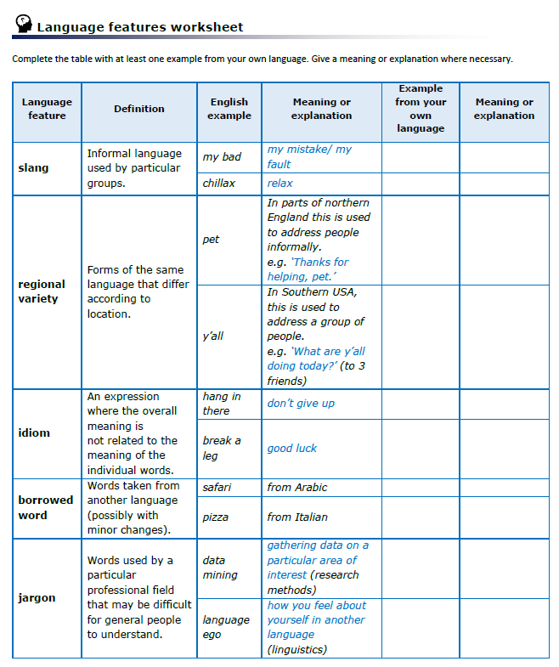

Getting started
Go to the ‘Language features worksheet’ you completed for homework.
Look at the answers from your group and select one language example that is particularly interesting. Prepare to tell the class about it.
Discuss the question below, using examples from the worksheet to support your ideas.
What differences across regions, social groups or generations do you notice in your language?

Slide 6


Getting started
Listen to an interview with Dr. Robert Weekly, Assistant Professor in Applied Linguistics at UNNC, about how the word gung-ho entered the English language.
Decide whether each statement below is True or False.
 |  | True or False
1 | In English, gung-ho means ‘acting without enough thinking or planning’. | T
2 | Rewi Ali, a businessman from New Zealand used the phrase with his own workers to try to inspire similar work values he had seen in China. | T
3 | An American military officer, Evans Carlson, also learnt the word while visiting China, and decided to use it to inspire his men. (Carlson learned about the word from Rewi Ali.) | F
4 | Evans Carlson was an excellent officer, but his men were impetuous and therefore acted without thinking. (Carlson was impetuous and acted without planning.) | F
5 | The word changed in meaning because of the way Evans Carlson’s unit operated. | T
6 | The stories behind many words in English are unknown to us. | T

Slide 7

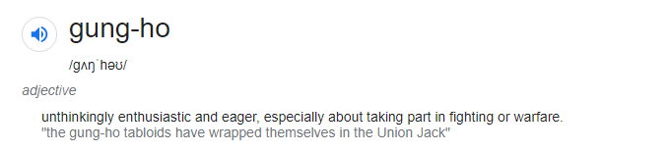
Getting started
Based on the story of gung-ho, what can we learn about how new words can enter a language?

Slide 8

Preparing for the lecture

Slide 9
Preparing for the lecture: Vocabulary building (A)
Check your answers to the homework task.
1. | When foreign armies invade a country, it can result in language change. | b
2. | Reading is a great way to expand your vocabulary. | d
3. | The phrase ‘my bad’ is an example of English slang. | g
4. | Lack of confidence in using new vocabulary is only temporary. | a
5. | Some fashionable words become outdated after some time. | i
6. | Urbanisation often results in many people sharing different languages. | c
7. | Certain words become more widespread because of popular use on social media. | e
8. | Some people believe that language can decay in the same way as old teeth. | j
9. | ‘Hang in there’, meaning ‘don’t give up’ is an English idiom. | f
10. | Many native speakers are ignorant of how English is used worldwide. | h
a | Non-permanent, only existing for a fixed or short period of time.
b | To enter and take over something by force.
c | The process whereby cities grow and people increasingly move to them.
d | To increase in size, number or importance.
e | Existing or happening in many places/ among many people.
f | An expression where the meaning is not related to the meaning of the individual words.
g | Informal language used by particular groups.
h | Lacking in knowledge or understanding about something.
i | No longer popular or not as good as something more modern.
j | Become bad or rotten, often caused by inappropriate treatment or lack of care.

Slide 10
Preparing for the lecture: Vocabulary building (B)
Check your answers to the homework task.
The words are:
different forms of words from the last task.
words that collocate (naturally go together) with words from the last task.
Words from the last task
1. | invade
2. | expand
3. | slang
4. | temporary
5. | outdated
6. | urbanisation
7. | widespread
8. | decay
9. | idiom
10. | ignorant
e.g. The widespread use of mobile phones has made communication easier.
Modern street designs make the u________ e____________ more appealing.
We generally try to avoid i__________ l__________ in academic writing.
The collection of people’s data by companies can be considered an i__________ o___ privacy.
Increased funding resulted in t_____ e__________ o_____ the project.
In politics, mistakes are often repeated due to an i__________ o_____ history.
Due to bad weather, train services are t__________ suspended.
urban environment
idiomatic language
invasion of
the expansion of
ignorance of
temporarily

Slide 11
Preparing for the lecture: Listening and note-taking focus
Examples
Examples are often given in lectures to show that an idea or concept exists in the real world. In this way, examples can provide support for ideas by making them more understandable and credible.
Common signposting language:
Selecting examples
It is important to make notes of examples so that you can fully understand an idea from a lecture several days, weeks or months later. However, you may need to be selective about which examples you note.
Some examples will be relevant (i.e. provide greater understanding of an idea and help you when revising).
Other examples may be irrelevant (e.g. the speaker may use them to help you connect to the topic, but you don’t need to remember them later).
For example…
For instance…
… such as…
… is an example of…
An example of this is…
Let me give you an example.

Slide 12
Preparing for the lecture: Listening and note-taking focus
Listen to an extract from a lecture on ‘Pidgins’ (simplified forms of language used between people with no common language).
As you listen write down all the signposting language that the speaker uses to introduce examples.
Listen again and write down the example that is introduced by the signposting language.
In your group, decide if each example is relevant or irrelevant.
 | Signposting language | Example | Relevant / Not relevant
1 | For instance | an experience I had was when I was studying language use in West Africa - I couldn’t understand some conversations because they were using a form of Pidgin English. | Not relevant
2 | Let me give you an example | Chinese Pidgin English, or CPE which was used between traders in Hong Kong from the 17th century to around the middle of the 20th century. It had influences from a number of languages- English, Cantonese, Portuguese and several others. | Relevant
3 | such as | all languages change, and it’s the same with Pidgins. Many simply die out → CPE | Relevant
4 | An example of this is | others grow and can develop into fully independent languages. → Bislama, which has become an official language of a country called Vanuatu. | Relevant

Slide 13

Listening to the lecture

Slide 14

Listening to the lecture: Lecture content focus
You are going to watch Lecture 4A ‘Language change: Good, bad or inevitable?’. The lecturer will discuss some of the factors that may cause a language to change.
Before watching the lecture, talk to your partner.
How do you think each of the factors below may influence a language?
Urbanisation
Globalisation
Youth culture
Modern technology & communication

Slide 15
Listening to the lecture: Listening
Watch Lecture 4A ‘Language change: Good, bad or inevitable?’ and take notes as you listen.

Slide 16
Listening to the lecture: Comprehension check - Main ideas
Use your notes to complete the main ideas below.
Main ideas
1 | English has many borrowed words from other languages because … of foreign influences and military invasions.
2 | Lexical expansion is when the vocabulary of a language grows because … new items/ concepts/ ideas that appear need words.
3 | Slang causes many changes in the language because … slang is often temporary.
4 | Media and Hollywood created a type of linguistic leveling because … many people were exposed to the same form of English.
5 | Globalization (and international English) is a cause of language change because … people need a common language to communicate.
6 | ‘Language purists’ believe … language becomes worse as it changes.

Slide 17
Listening to the lecture: Comprehension check - Details
Select the appropriate example for each main idea from the list.
Examples
a | The word groovy (which means cool)
b | Armies from France took over England in 1066
c | Germans and Japanese business communication in English
d | Samuel Johnson produced a dictionary to preserve ‘proper’ forms of English
e | Words related to computers- spreadsheet, internet, download
f | American English features used by New Zealanders (1990s)
Main ideas |  | Example
1 | English has many borrowed words from other languages because of foreign influences and military invasions. | b
2 | Lexical expansion is when the vocabulary of a language grows because new items/ concepts/ ideas that appear need words. | e
3 | Slang causes many changes in the language because slang is often temporary. | a
4 | Media and Hollywood created a type of linguistic leveling because many people were exposed to the same form of English. | f
5 | Globalization (and international English) is a cause of language change because people need a common language to communicate. | c
6 | ‘Language purists’ believe language becomes worse as it changes. | d

Slide 18
Listening to the lecture: Listening reflection
Compare the two sample sets of notes from a part of today’s lecture. Which do you think is a more usable set of notes? Why?
The examples have context, so we can see how they apply.
Sample A
Sample B
Lexical expansion
Need words for new items
e.g. coffee, tobacco, spreadsheet, download
Lexical expansion
Need words for new items
e.g. coffee, tobacco introduced in 16th/ 17th cent.
Modern e.g. spreadsheet, download (tech words)
The examples …
have no context, so they have little meaning.
are bullet-pointed the same way as other details. This could cause confusion.
don’t stand out for easy recognition.
The examples are in indented bullet-points to indicate relationship with the above detail.
The examples stand out for easy recognition (i.e. in a different colour).

Slide 19

Developing the topic

Slide 20
Developing the topic
Using your own ideas and information from the video lecture, the lesson and the Language features worksheet, discuss the question below in your group.
Discuss at least three ways. Provide clear examples to develop your answers.
How and why do languages change?

Slide 21

Developing the topic: Language invasion
Game: Language invasion
 |  | A | B
1 | semester
2 | online
3 | zero
4 | ketchup
5 | shampoo
6 | robot
7 | nice
8 | tattoo
9 | alligator
Preparation
You and your partner are a team for this game.
Your team will be given one word from the list, along with some information about how the word entered the English language.
Create some fake information to try to fool other teams about the true facts.
After that, you should have two pieces of information: one true and one false.
You and your partner should each memorize one piece of information.
Game
Stand up and in your team talk to another team. Tell the other team your word and the two pieces of information.
The other team will make a note of which they think is the correct answer (A or B). Don’t tell them the answer.
Swap roles.
Talk to another team, until you have talked to all the teams.
At the end of the game, you will check your answers together as a class.

Slide 22
Developing the topic: Language invasion
Game: Language invasion
You get one point for each answer that you guessed correctly. The team with the highest number of points wins.
 |  | A or B?
1 | semester | (A) German, 19th century. Germany’s education system was very modern, and England used many of its ideas.
2 | online | (B) American railway system, 19th century. If a town was online, it had a station. It later became more widely used to mean connected to a network.
3 | zero | (B) Arabic region, 14th century. Arabs were the most advanced in mathematics, so many mathematics words come from this area.
4 | ketchup | (A) China, 18th century. Originally it was a Chinese sauce made of pickled fish and spices.
5 | shampoo | (A) India, 19th century. India was part of the British Empire, and British soldiers had their hair washed by local people.
6 | robot | (B) Czech Republic, 1920s. Czech science fiction writer Karel Capek invented it.
7 | nice | (A) France, 13th century. The original meaning was foolish. ‘Your clothes look nice’ meant your ‘clothes are too much’.
8 | tattoo | (B) South Pacific Islands, 18th century. British explorers visited the islands, and some got tattoos from the local people.
9 | alligator | (A) English playwright William Shakespeare, 16th century. He used it in his most famous play, Romeo & Juliet.

Slide 23
Homework
Due | Task
Lesson 6.2 | Watch the YouTube video ‘Saving languages from extinction’ and make notes. Bring your notes to class. You can find the link to the video on the OCSa Moodle page, in the Week 6 section. N.B. You should be connected to eduroam wifi to watch the video.

Slide 24



Week 6
Extra resources for OCSa this week on the Writing Lab Moodle page:
Listening → Lecture listening
Speaking → University speaking tasks
Next week (Week 7 – beginning the 11th of November):
Utalk continues!
Lunch time 1:00 – 1:50.
Monday, Tuesday, Wednesday, Thursday, Friday: PB 115
Evening sessions available – check the SPDPO credit system.
Sign-up using the SPDPO credit system.
Centre for English Language Education CELE N048 AY 24-25

Slide 25
Oral Communication Skills A
(CELEN069)
Lesson 6.2

Slide 26
Lesson aims and objectives
By the end of this lesson, you should have enhanced your speaking and listening ability through practice.
In addition, you should be better able to … | Intended Learning Outcomes
rank and summarise ideas during a discussion | 1.1-1.6 2.5
use appropriate language to rank and summarise during a discussion

Slide 27
Getting started

Slide 28

Getting started
As a class, stand in 2 lines (A & B). Make sure you are facing a classmate.
Discuss statement 1 below for one minute.
Then, line A move left to the next person, line B stay where you are.
Discuss statement 2 for one minute.
Keep going until you have discussed all five statements with a different classmate.
Language change is a positive thing.
It is important to save endangered languages.
It is possible to save endangered languages.
English as an International Language harms other languages.
English teachers have a responsibility to other languages and cultures.

Slide 29

Language and skills
focus

Slide 30
Language and skills focus: Ranking and summarising
In some academic discussions you may simply be asked to talk about a topic, while in others you will be given a discussion task. If there is a discussion task, certain stages will be necessary to complete it successfully.
In your Group Discussion Exam you will be asked to identify 2-3 features of a topic and then rank them. The stages for this are:
Opening
Gathering ideas: identification of 2-3 features (& summarising before moving to the next stage)
Ranking the ideas
Concluding (summarising the discussion)
Today, we will focus on the skills of ranking and summarising.

Slide 31
Language and skills focus: Ranking and summarising
Ranking
It is good to begin the ranking stage by clearly stating the 2-3 features you have selected. Then, you should compare and contrast the features to try to decide an order. REMEMBER: you are working as a team, so you should try to reach a consensus – an agreement – about the ranking order.
Summarising
As in other forms of academic work, it is good to provide a summary at the end of a discussion. This helps remind the participants what has been said and helps to check that there is a common understanding. In a timed discussion, the summary can be very brief or more expansive depending on the time left.
Brief summarising can also occur at the end of other discussion stages. This can ensure that all participants are aware of what has already been discussed before moving on.

Slide 32
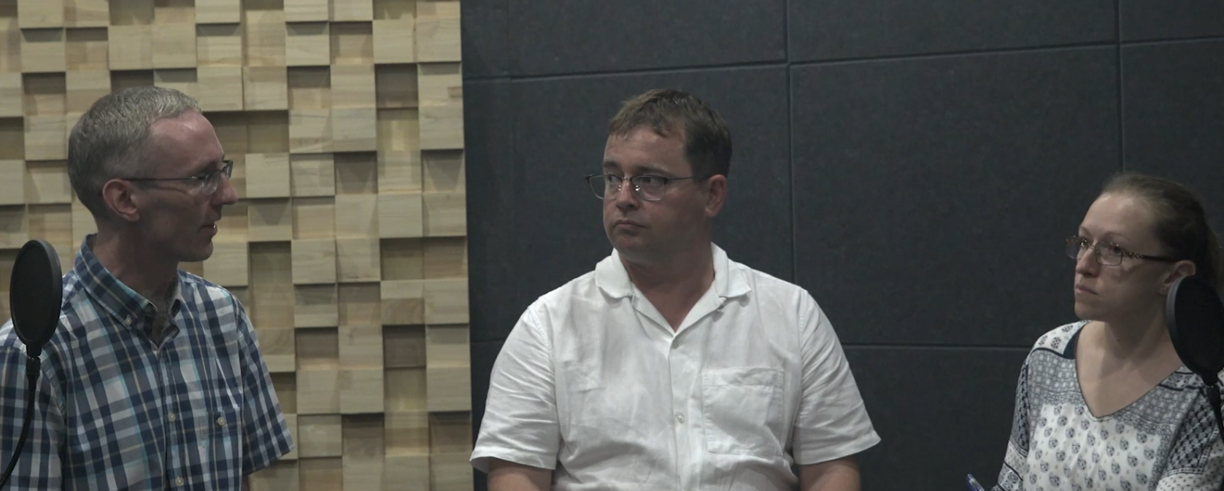
Language and skills focus: Ranking and summarising
Watch a video that contains the ranking and summarising stages of a discussion.
Discussion prompt:
Watch the video and make notes on the features they identified, and on the agreed ranking order.
Identify 2-3 ways in which English as an international language changes local cultures. Rank them in order of impact.
Promotion of local cultures through English
Influence of popular culture on local cultures
Loss of local languages
3
2
1
Robert
John
Michaela

Slide 33
Language and skills focus: Ranking and summarising
Go to the Lesson 6.2 Ranking and Summarising in your Class Workbook. Look at the speaking turns numbered 1-6 in the transcript.
Match each numbered speaking turn to the speaker’s purpose from the table below.
Speaking turn
Purpose | The speaker…
a | gives an opinion for the top ranked idea with justification.
b | summarises the rankings agreed by the group.
c | summarises the 3 ideas and suggests the group should rank them.
d | gives a different opinion for the top ranked idea with justification.
e | concludes the group’s consensus on a ranking and moves on to the next ranking.
f | clarifies the previous speaker’s opinion.
2
6
1
3
5
4

Slide 34
Language and skills focus: Ranking and summarising
Close the Class Workbook.
Your tutor will give you a printed copy of a partial transcript of the discussion.
Mutual dictation.
Use the partial transcripts to role-play the discussion.
Student A: You will play the role of John
Student B: You will play the role of Michaela
Student C: You will play the role of Robert
Help each other to fill in the blank spaces with the missing language that the three speakers used for the purpose of ranking and summarising.

Slide 35
Discussion focus

Slide 36
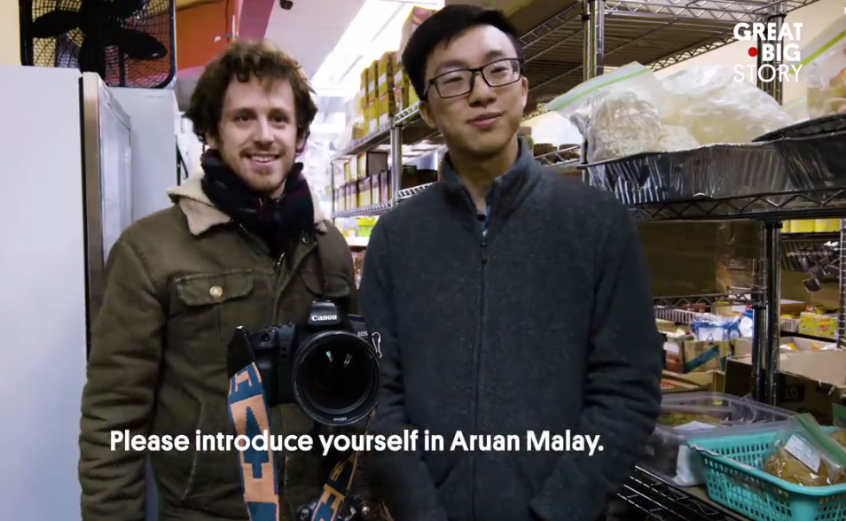
Discussion focus: Prepare
In Lecture 4A, you heard about how languages change. Also, for homework you watched a YouTube video about how to save languages from extinction.
Using information from these sources and your own ideas, make a list of measures that can be taken to preserve endangered languages.
You have 2 minutes.

Slide 37
Discussion focus: Discuss
In your group, have a discussion based on the prompt in the box.
Agree on 2-3 measures that can be taken to preserve endangered languages.
Rank them starting with the most effective.
This prompt is similar to the final Group Discussion Exam.

Slide 38
Discussion focus: Reflect
Reflect on your group discussion and answer the questions below.
 |  | Yes | Partly | No
My group | We used all the time
 | We agreed on 2-3 features of the topic
 | We ranked the features
 | We summarized the discussion
Me | I helped developed the ideas of other group members
 | I supported my ideas and opinions
 | I contributed at both the ‘agree on 2-3’ and the ‘ranking’ stages
1 or 2 things I did well…
1 or 2 things I could do better in the next discussion…

Slide 39
Week 6
Extra resources for OCSa this week on the Writing Lab Moodle page:
Listening → Lecture listening
Speaking → University speaking tasks
Next week (Week 7 – beginning the 11th of November):
Utalk continues!
Lunch time 1:00 – 1:50.
Monday, Tuesday, Wednesday, Thursday, Friday: PB 115
Evening sessions available – check the SPDPO credit system.
Sign-up using the SPDPO credit system.
Centre for English Language Education CELE N048 AY 24-25

Slide 40

Homework
Due | Task
Independent Learning Week | Watch Lecture 4B: Endangered languages and take notes. You will use these notes later when you revise for the Group Discussion Exam. Watch the two group discussion videos (on Moodle, in the Week 7 section) and complete the tasks. Complete the tasks on summary writing. You will need these skills for Listening Portfolio Task 3. Use Gibbs’ reflective cycle to reflect on your performance on Listening Portfolio Task 1 (Class Workbook, p.49).
Lesson 8.1 | Review Pronunciation Quiz and Pronunciation Workshop 1.

